Slide 1
Data Mining and Data Warehousing Presentation
Title: Market Basket Analysis
Presented By
Mr. Akash Shankar 1BY18IS016
Mr. Ankith Praveen 1BY18IS026
Mr. Guru Dut 1BY18IS049
Mr. N Rafaath 1BY18IS070

Slide 2
INTRODUCTION
Association Rule Mining is used when you want to find an association between different objects in a set, find frequent patterns in a transaction database, relational databases or any other information repository. The applications of Association Rule Mining are found in Marketing, Basket Data Analysis (or Market Basket Analysis) in retailing, clustering and classification.
The most common approach to find these patterns is Market Basket Analysis, which is a key technique used by large retailers like Amazon, Flipkart, etc to analyze customer buying habits by finding associations between the different items that customers place in their “shopping baskets”. The discovery of these associations can help retailers develop marketing strategies by gaining insight into which items are frequently purchased together by customers.

Slide 3
PROBLEM STATEMENT
Market-Basket-Analysis
Using Apriori Algorithm to do Market Basket Analysis of Customers purchasing behaviours. It can predict what the customer is going to buy next by looking at the products he is buying.

Slide 4
DecisionTreeClassifier is a class capable of performing multi-class classification on a dataset.
Apriori Algorithm
Apriori is an algorithm used for Association Rule Mining. It searches for a series of frequent sets of items in the datasets. It builds on associations and correlations between the itemsets. It is the algorithm behind “You may also like” where you commonly saw in recommendation platforms.
ARM( Associate Rule Mining) is one of the important techniques in data science. In ARM, the frequency of patterns and associations in the dataset is identified among the item sets then used to predict the next relevant item in the set. This ARM technique is mostly used in business decisions according to customer purchases.

Slide 5
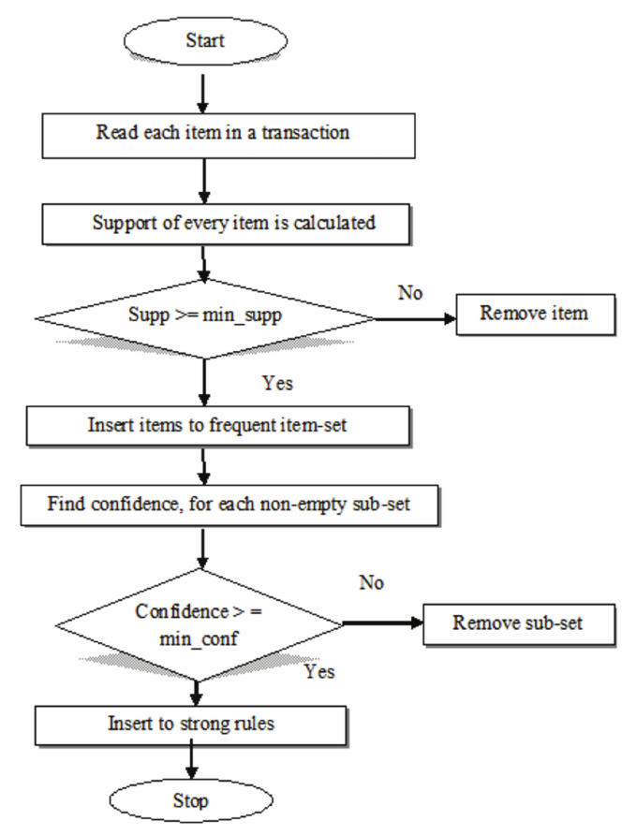
General approach for building a Apriori model

Slide 6
Association Rules
The terms used for devising the association rules to predict the market basket analysis are:
Support: It's the default popularity of an item. In mathematical terms, the support of item A is nothing but the ratio of transactions involving A to the total number of transactions.
Confidence: Likelihood that customer who bought both A and B. Its divides the number of transactions involving both A and B by the number of transactions involving B.
Confidence(A => B) = (Transactions involving both A and B)/(Transactions involving only A)

Slide 7
Lift :
Increase in the sale of A when you sell B.
Lift(A => B) = Confidence(A, B) / Support(B)
Likelihood of a customer buying both A and B together is ‘lift-value’ times more than the chance if purchasing alone.
Lift (A => B) = 1 means that there is no correlation within the itemset.
Lift (A => B) > 1 means that there is a positive correlation within the itemset, i.e., products in the itemset, A, and B, are more likely to be bought together.
Lift (A => B) < 1 means that there is a negative correlation within the itemset, i.e., products in itemset, A, and B, are unlikely to be bought together.

Slide 8
Association Rule-based algorithms are viewed as a two-step approach:
Frequent Itemset Generation: Find all frequent itemsets with support >= predetermined min_support count
Rule Generation: List all Association Rules from frequent itemsets. Calculate Support and Confidence for all rules. Prune rules that fail min_support and min_confidence thresholds.

Slide 9
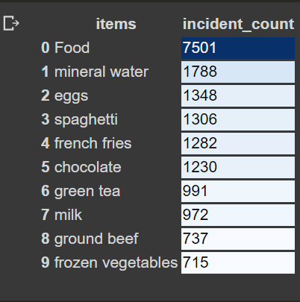
Exploratory Data Analysis

Slide 10
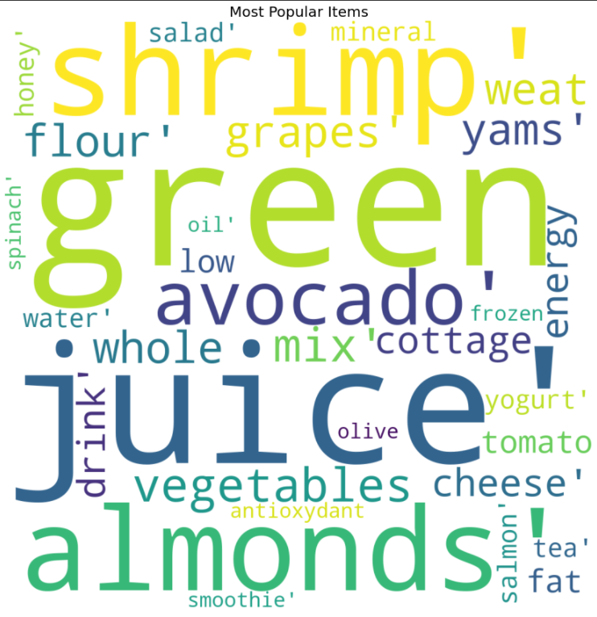

Slide 11
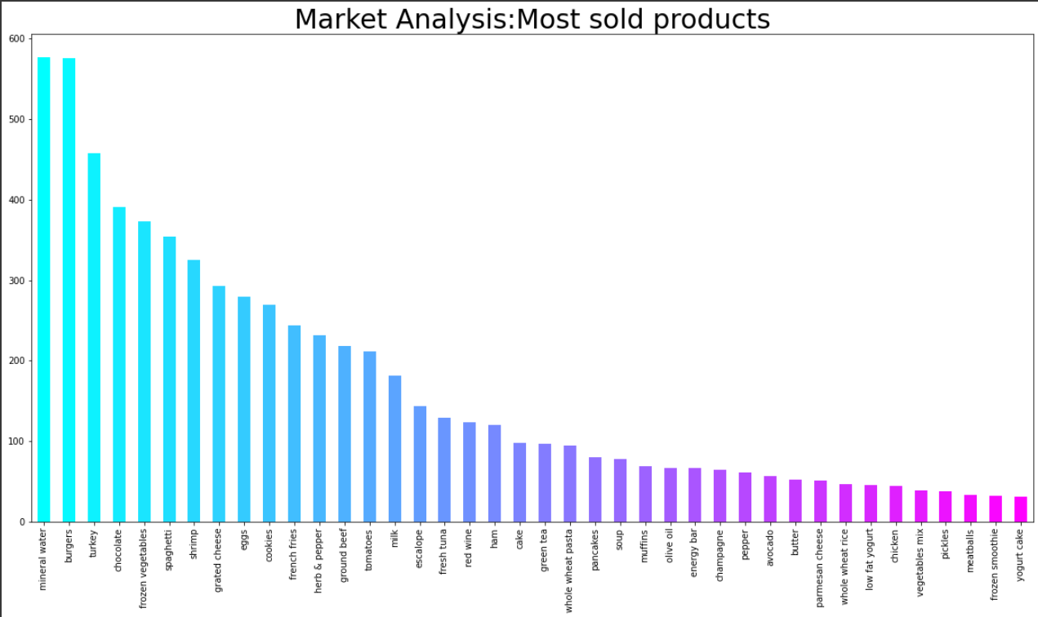

Slide 12
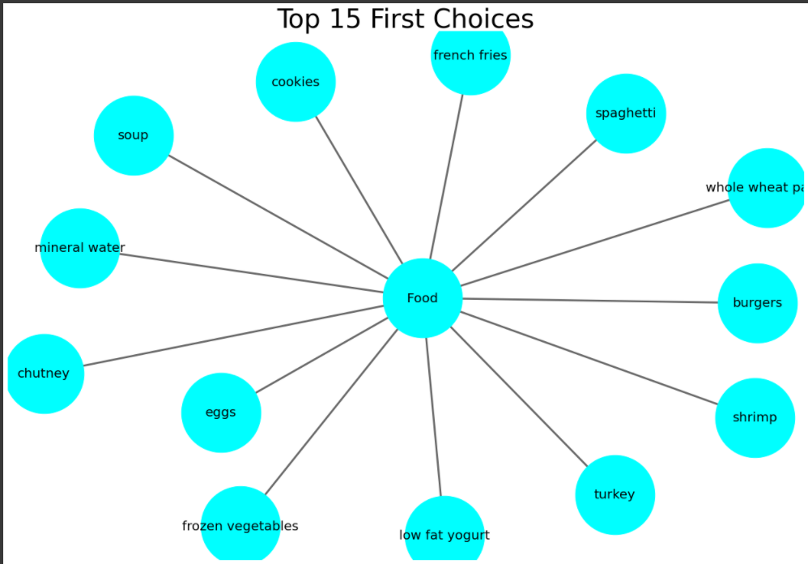

Slide 13
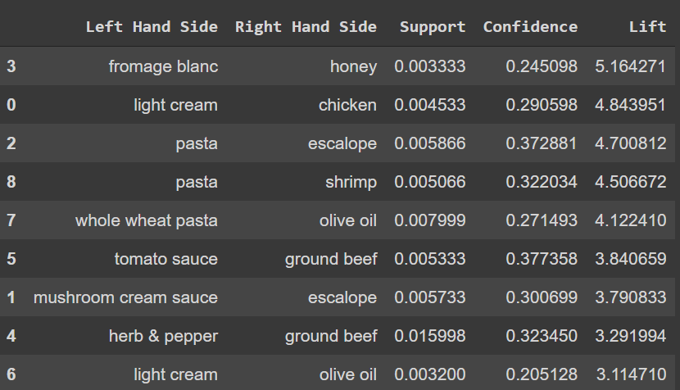
OUTPUT

Slide 14
References
https://www.kaggle.com/mariekaram/apriori-association-rule
https://www.kdnuggets.com/2016/04/association-rules-apriori-algorithm-tutorial.html
https://towardsdatascience.com/association-rules-2-aa9
https://michael.hahsler.net/research/recommender/associationrules.html
https://en.wikipedia.org/wiki/Association_rule_learning

Slide 15
Thank You

